Slide 1
MODULE – 1
Multithreading in Java

Slide 2
Contents
Multithreading Introduction
The Thread class & Runnable Interface
Thread Priority
Thread Synchronization
Inter-thread communication
Executor Framework (Knowledge level)

Slide 3
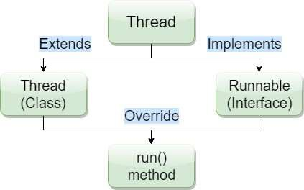
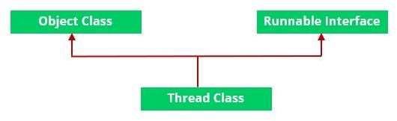
Multithreading
Multithreading is a Java feature that allows concurrent execution of two or more parts of a program for maximum utilization of CPU.
Each part of such program is called a thread.
So, threads are light-weight processes within a process.
Threads can be created by using two mechanisms: Method 1. Extending the Thread class
Method 2. Implementing the Runnable Interface

Slide 4
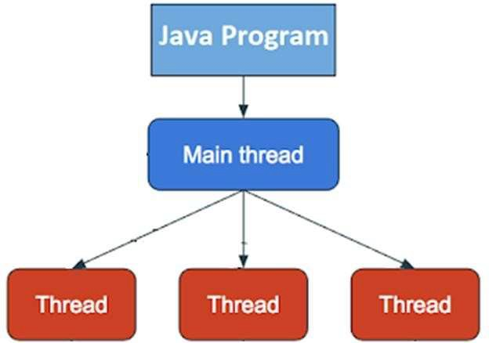
Multithreading
When a Java program starts, one thread known as main thread is created, which executed code written inside the main method, if you create a thread, then those threads are created and started by the main thread, once started they start executing code written in their run() method.
Three different kinds of issues:
Issues, which always comes
Issues, which comes only sometimes, but consistent with the same input
Issues, which is truly random

Slide 5
Method 1. Thread class
Method 2. Runnable Interface
Thread class
Runnable
Sample Class
Sample Class
Thread Class vs Runnable Interface
If we extend the Thread class, our class cannot extend any other class because Java doesn’t support multiple inheritance. But, if we implement the Runnable interface, our class can still extend other base classes.
We can achieve basic functionality of a thread by extending Thread class because it provides some inbuilt methods like yield(), interrupt() etc. that are not available in Runnable interface.

Slide 6
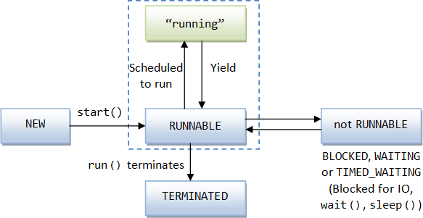
Life cycle of a Thread (Thread States)
According to sun, there is only 4 states in thread life cycle in java
New,
Runnable,
Not-runnable and
Terminated.
There is no running state.
threadStates.java

Slide 7
Life cycle of a Thread (Thread States): The Thread Class and Methods
yield(), or time out
Running
run() returns
Thread created
start()
New
Ready
run()
join()
Terminated
interrupt()
sleep()
Target finished
wait()
Wait for target to finish
Wait for time out
Time out
Wait to be notified
notify() or notifyAll()
Blocked
Interrupted()
th

Slide 8
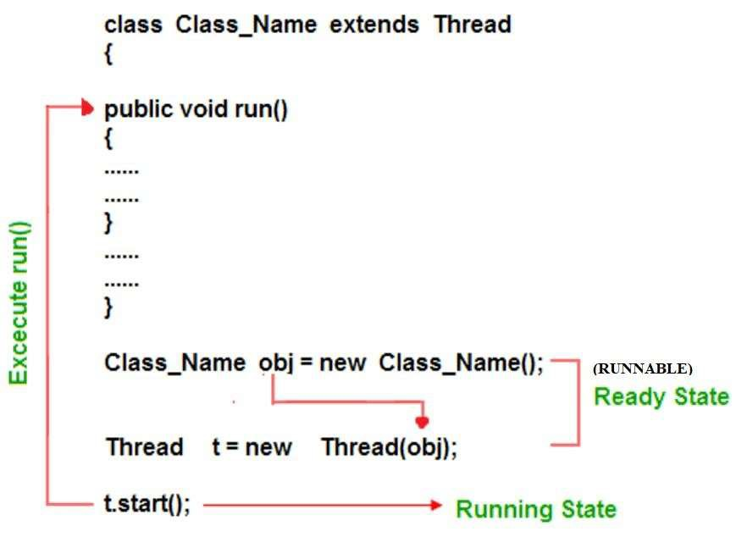
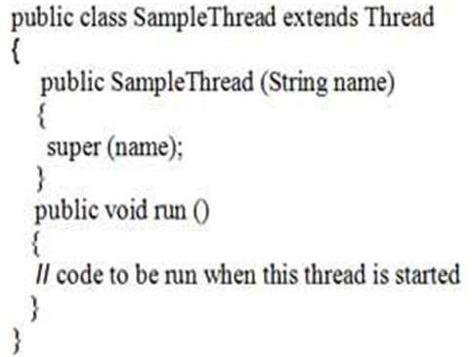
Thread
Method 1. Syntax:
extends
Sample
Example:

Slide 9
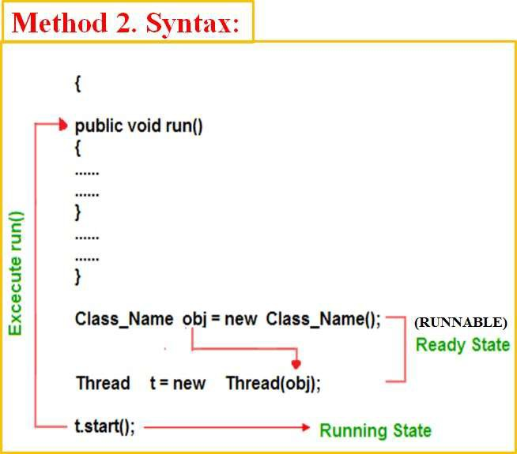
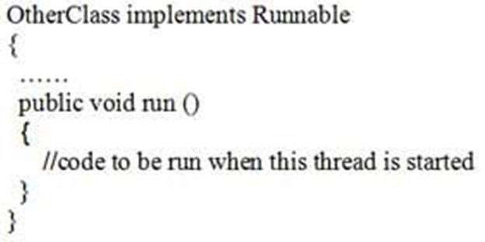
Runnable
implements
Class Class_Name Implements
OtherClas
Example:

Slide 10
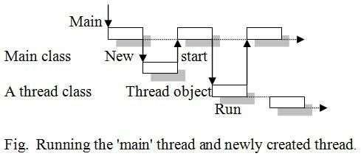
Example: thread1.java
Thread
//Program Using extends to write a single-thread program. import java.lang.*;
class ThreadExample extends Thread { public ThreadExample (String name) {
extends
ThreadExample
super (name);
}
public void run () {
System.out.println (Thread.currentThread ()); For (int i=0; i<=5; i++)
System.out.println (i);
}
}
public class thread1 {
public static void main (String args [ ]) { ThreadExample obj = new ThreadExample ("First"); obj.start ( );
System.out.println (''This is:" + Thread.currentThread ());
OUTPUT:
This is: Thread [main, 5, main]
Thread [First, 5, main]
}
}

Slide 11
Example: thread2.java
Runnable
//Program illustrates the creation of threads using Runnable interface.
class ThreadExample implements Runnable { Thread t;
implements
ThreadExample
public ThreadExample (String ThreadName) { t = new Thread (this, ThreadName);
}
public void run () {
System.out.println (Thread.currentThread () ); for (int i =0; i <=5; i++)
System.out.println (i);
}
}
public class thread2 {
public static void main (String args [ ]) { ThreadExample obj = new ThreadExample(“First”); obj.t.start ( );
System.out.println ("This is:" + Thread.currentThread ());
}
}
OUTPUT:
This is: Thread [main, 5, main]
Thread [First, 5, main]

Slide 12
The Thread Class and Methods:
The Following methods are invoked on a particular Thread object.
«interface»
java.lang.Runnable
Some methods are not available
java.lang.Thread |  | DESCRIPTION
+Thread() +Thread(task: Runnable) +start(): void +isAlive(): boolean +setPriority(p: int): void +join(): void +sleep(millis: long): void +yield(): void +interrupt(): void | Creates a default thread. Creates a thread for a specified task. Starts the thread that causes the run() method to be invoked by the JVM. Tests whether the thread is currently running. Sets priority p (ranging from 1 to 10) for this thread. Waits for this thread to finish. Puts the runnable object to sleep for a specified time in milliseconds. Causes this thread to temporarily pause and allow other threads to execute. Interrupts this thread.

Slide 13
The Thread Class and Methods:
The Following methods are invoked on a particular Thread object.
Sr. No. | Method & Description
1 | public void start() Starts the thread in a separate path of execution, then invokes the run() method on this Thread object.
2 | public void run() If this Thread object was instantiated using a separate Runnable target, the run() method is invoked on that Runnable object.
3 | public final void setName(String name) Changes the name of the Thread object. There is also a getName() method for retrieving the name.
4 | public final void setPriority(int priority) Sets the priority of this Thread object. The possible values are between 1 and 10.
5 | public final void setDaemon(boolean on) A parameter of true denotes this Thread as a daemon thread.
6 | public final void join(long millisec) The current thread invokes this method on a second thread, causing the current thread to block until the second thread terminates or the specified number of milliseconds passes.
7 | public void interrupt() Interrupts this thread, causing it to continue execution if it was blocked for any reason.
8 | public final boolean isAlive() Returns true if the thread is alive

Slide 14
The Thread Class and Methods:
The following methods in the Thread class are static. Invoking one of the static methods performs the operation on the currently running thread.
Sr. No. | Method & Description
1 | public static void yield() Causes the currently running thread to yield to any other threads of the same priority that are waiting to be scheduled.
2 | public static void sleep(long millisec) Causes the currently running thread to block for at least the specified number of milliseconds.
3 | public static boolean holdsLock(Object x) Returns true if the current thread holds the lock on the given Object.
4 | public static Thread currentThread() Returns a reference to the currently running thread, which is the thread that invokes this method.
5 | public static void dumpStack() Prints the stack trace for the currently running thread, which is useful when debugging a multithreaded application.

Slide 15
Thread Methods: The isAlive() Method:
threadisAlive.java
It tests if this thread is alive. A thread is alive if it has been started and has not yet died.
method used to find out the state of a thread.
returns true: thread is in the Ready, Blocked, or Running state
returns false: thread is new and has not started or if it is finished.
Syntax:
final boolean isAlive( )
Thread Methods: The interrupt () Method
threadInterrupt.java
If any thread is in sleeping or waiting state (i.e. sleep() or wait() is invoked), calling the interrupt() method on the thread, breaks out the sleeping or waiting state throwing InterruptedException.
If the thread is not in the sleeping or waiting state, calling the interrupt() method performs normal behavior and doesn't interrupt the thread but sets the interrupt flag to true.

Slide 16
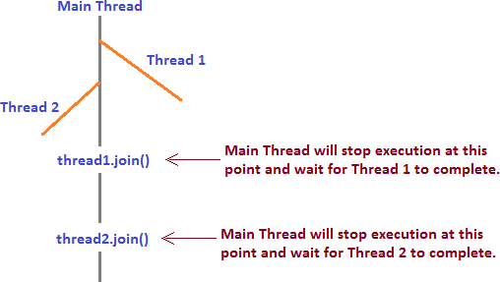
Thread Methods: The join() Method
join() method is used for waiting the thread in execution until the thread on which join is called is not completed. Remember, the thread which will wait is the thread in execution and it will wait until the thread on which join method called is not completed.
You can use the join() method to force one thread to wait for another thread to finish.
Syntax:
final void join( ) throws InterruptedException
Threadwithoutjoin.java
Threadjoin.java

Slide 17
Thread Methods: deprecated: stop(), suspend(), and resume() Methods
Whenever we want to stop a thread from running state by calling stop() method of Thread class in Java. This method stops the execution of a running thread and removes it from the waiting threads pool and garbage collected. A thread will also move to the dead state automatically when it reaches the end of its method. The stop() method is deprecated in Java due to thread-safety issues.
Syntax:
public final void stop()
The suspend() method of thread class puts the thread from running to waiting state. This method isused if you want to stop the thread execution and start it again when a certain event occurs.
Syntax:
public final void suspend()
The resume() method of thread class is only used with suspend() method. This method is used to resume a thread which was suspended using suspend() method. This method allows the suspended thread to start again.
Syntax:
public final void resume()

Slide 18
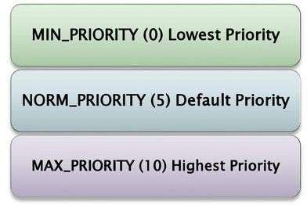
Thread Priority:
threadPriority.java
Each thread is assigned a default priority of Thread.NORM_PRIORITY (constant of 5).
You can reset the priority using setPriority(int priority).
Some static integral constants for priorities included in Thread Class:
By default, a thread has the priority level of the thread that created it.

Slide 19
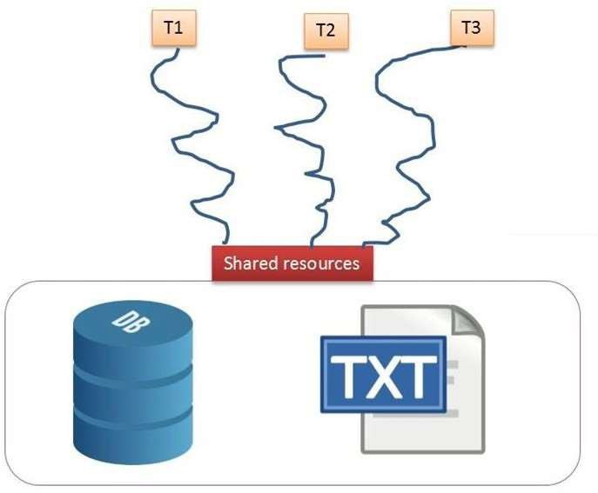
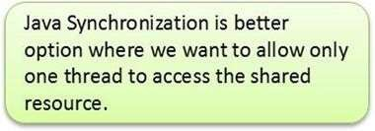
Thread Synchronization
threadnonsync.java
In Java, the threads are executed independently to each other. These types of threads are called as asynchronous threads. But there are two problems may be occur with asynchronous threads.
Two or more threads share the same resource (variable or method) while only one of them can access the resource at one time.
Race Condition
Resource Conflict

Slide 20
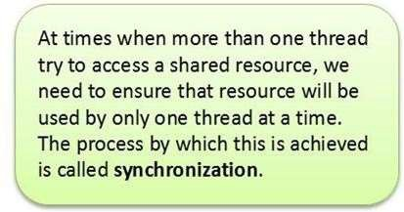
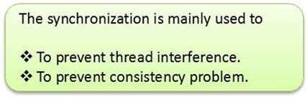
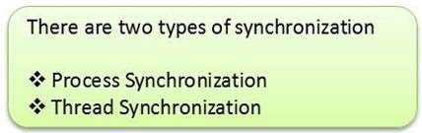
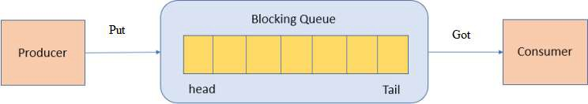
Thread Synchronization
If the producer and the consumer are sharing the same kind of data in a program then either producer may produce the data faster or consumer may retrieve an order of data and process it without its existing.
Producer Consumer Problem

Slide 21
Thread Synchronization
threadsyncB.java threadsyncM.java
There are two ways to synchronized the execution of code:
Synchronized Methods
Synchronized Blocks (Statements)
General form of synchronized Method is:
General form of synchronized block is:
synchronized returntype MethodName (param_List)
{
// statements in the method Body
}
synchronized (object reference expression)
{
// statements to be synchronized
}

Slide 22
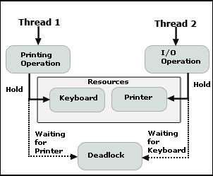
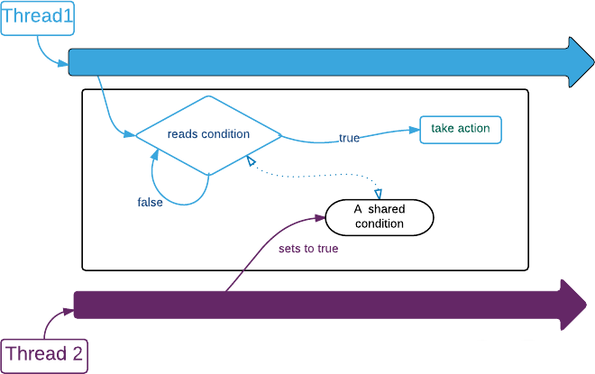
Inter-thread communication
threadInterNonCom.java
AFTER SYNCHRONIZATION
Problem: DeadLock
Solution: Inter-Thread Communication

Slide 23
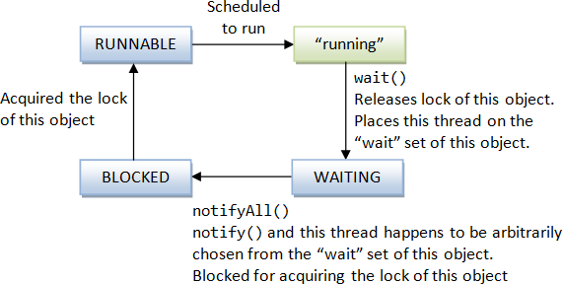
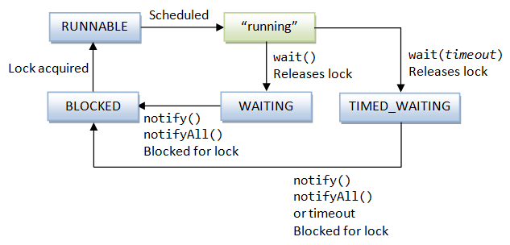
Inter-thread communication
wait(), notify() & notifyAll()
wait() with timeout

Slide 24
Inter-thread communication
threadInterCom.java
Java provide benefits of avoiding thread pooling using inter-thread communication. The wait(), notify(), and notifyAll() methods of Object class are used for this purpose. These method are implemented as final methods in Object, so that all classes have them. All the three method can be called only from within a synchronized context.
wait() tells calling thread to give up monitor and go to sleep until some other thread enters the same monitor and call notify.
notify() wakes up a thread that called wait() on same object.
notifyAll() wakes up all the thread that called wait() on same object.
These methods are declared within Object, as shown here:
final void wait( ) throws InterruptedException
final void notify( )
final void notifyAll( )
Producer Consumer Problem

Slide 25
Executor Framework
With the traditional approach of thread creation, When we create a new thread for executing a new task cause overhead of thread creation, In order to manage this thread life-cycle, the execution time increase respectively.
Java has flexible thread pool implementation, called the Executor framework.
A framework having a bunch of components that are used for managing worker threads efficiently is referred to as Executor Framework.
The Executor API reduces the execution of the task from the actual task to be executed through the Executors.
The executor framework is an implementation of the Producer-Consumer pattern. The java.util.concurrent.Executors class provides a set of methods for creating ThreadPools of worker threads.
Required for efficient Java multithreading.

Slide 26
Executor Framework
public interface Executor {
void execute(Runnable command) ;
}
Based on producer/consumer pattern
Producers submit tasks and consumers consume tasks
Decouples task submission from task execution

Slide 27
Executor Framework
Based on producer/consumer pattern
Decouples task submission from task execution
The value of decoupling task submission from execution allows us to easily change the execution policy
An execution policy specifies :
In what thread a task will execute
In what order tasks will be executed
How many tasks may execute concurrently
How many tasks may be pending
Which tasks to reject if the system is overloaded

Slide 28
Module – 1 Completed

